Slide 1
ACID NEUTRALIZATION POWER OF COMMON ANTACIDS
A few commercially available antacids are bases that stoichiometrically react with acid.
These medicines are used to treat the symptoms of acid reflux.
Mild base like Aluminum and magnesium hydroxides are antacids that work quickly to lower the acid in the stomach.
Liquid antacids usually work faster/better than tablets.

Slide 2
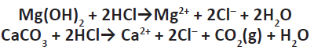
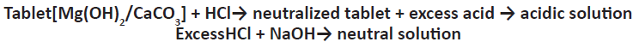
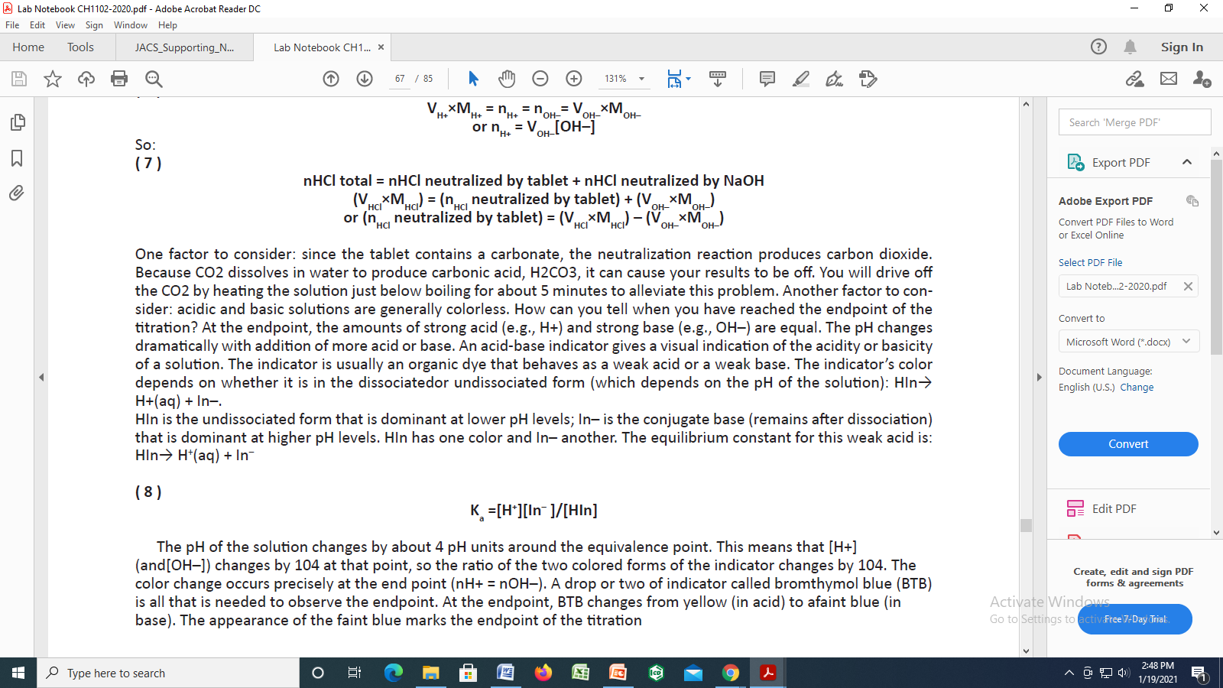

Slide 3
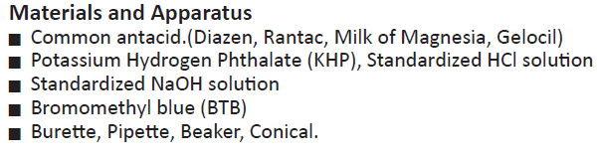

Slide 4
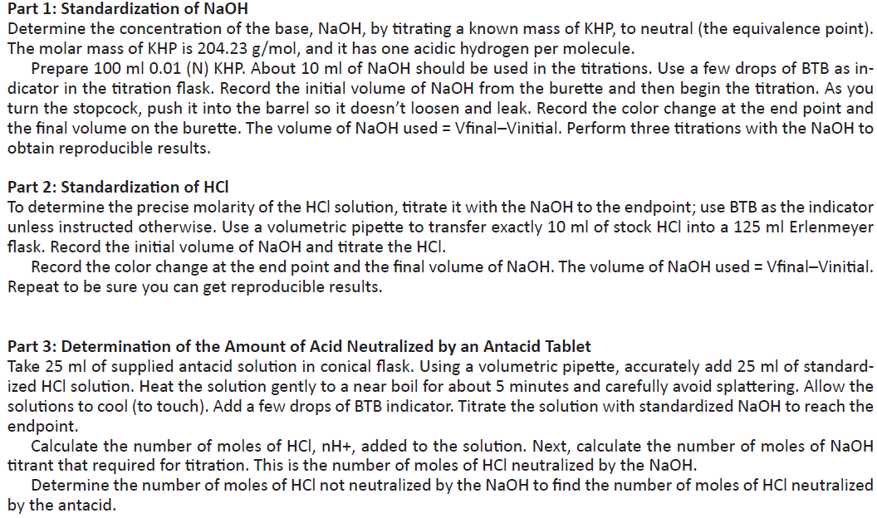

Slide 5
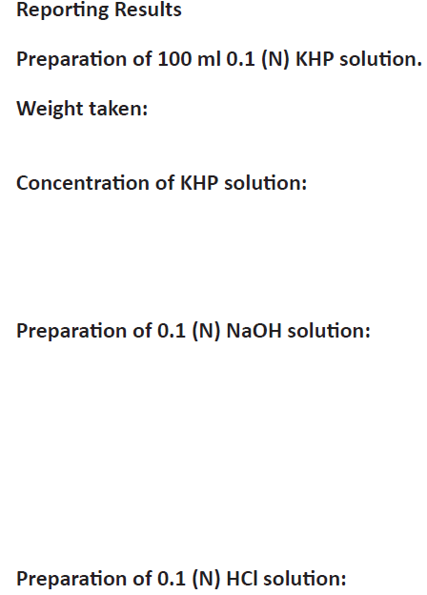
2.042 gm
0.1 N
0.1 N supplied
0.1 N supplied

Slide 6
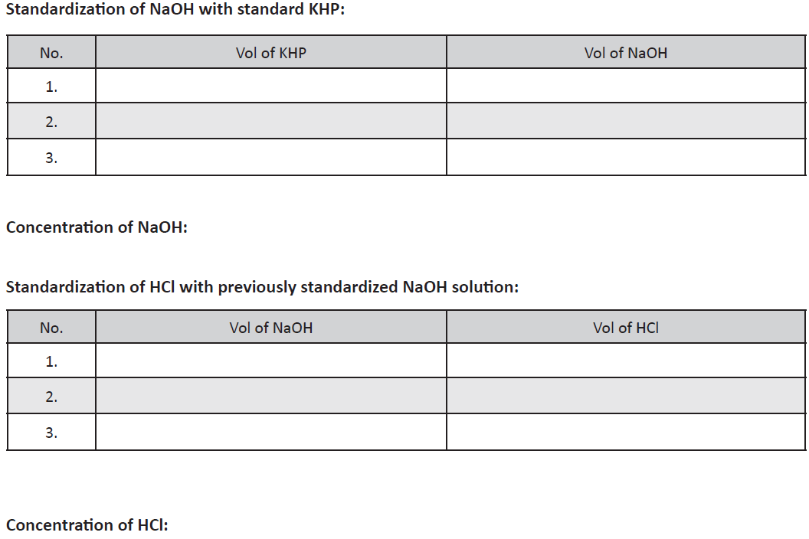
25 mL
V1XS1 = V2XS2
25 mL
V1XS1 = V2XS2

Slide 7
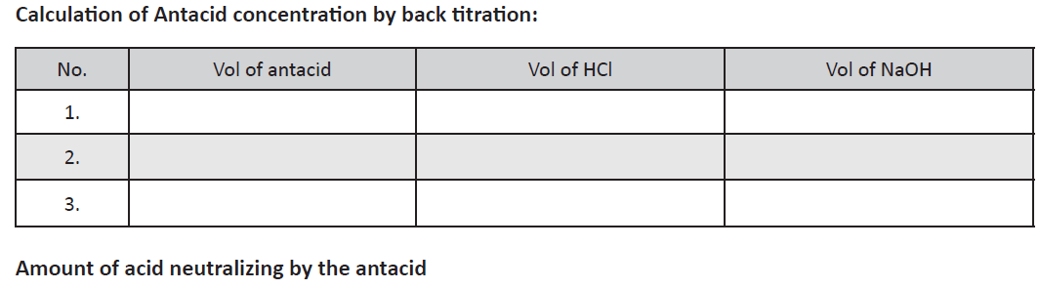
25 mL
25 mL

